Slide 1

Analysis on Top 15 Holiday Destinations for TTA
Author : Lisa Duffy

Slide 2
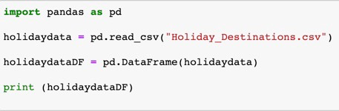
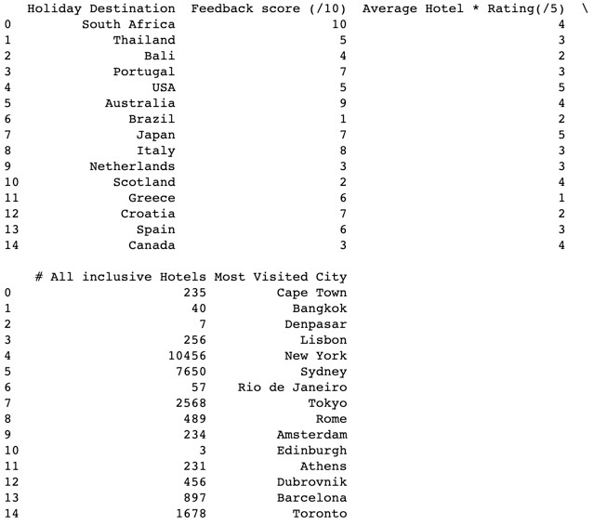

Data File Structure
1.How many rows and columns are there in your file?
After importing the Pandas module and reading the csv file which was created in EXCEL into a dataframe, I used the shape function in the Pandas module to determine that there are 15 ROWS and 5 COLUMNS in the data file.

Slide 3
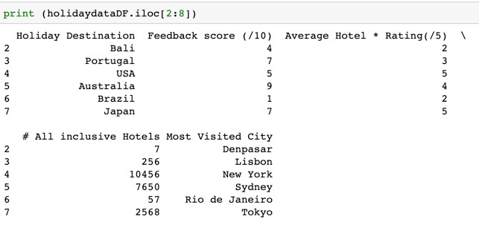
Selection of data in row positions
2.Print row 3-8 ( using iloc/loc).
Using the iloc function in the Pandas module I selected the data from rows 3 – 8 in the spreadsheet and printed to the screen.

Slide 4
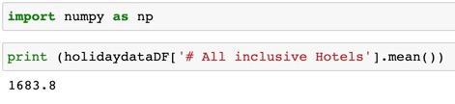
Data Calculations
3. Find the mean number of all-inclusive hotels across all destinations.
Using the NumPy module in addition to the Pandas module I was able to use a function to calculate the mean number of the all-inclusive hotels across all data provided. The was an indication of the average number of all-inclusive hotels in the holiday destinations that were included in the data provided.
The answer was : 1683.8

Slide 5
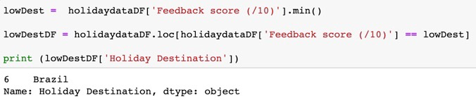
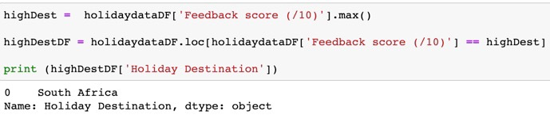
Data Selection
4.Find the lowest scoring destination.
Using the min function in the Pandas module I was able to select the holiday destination that had the lowest feedback score.
The result of my selection on the given data was: BRAZIL
5.Find the highest scoring destination.
Using the max function in the Pandas module I was able to select the holiday destination that had the highest feedback score.
The result of my selection on the given data was: SOUTH AFRICA

Slide 6
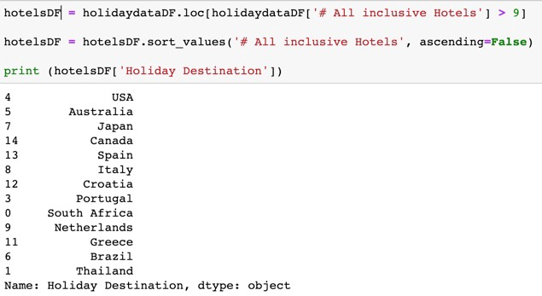
Data Selection 2
6.Find all the destinations where there are more than 9 all-inclusive hotels.
Certain clients favour all-inclusive hotels and so it would be useful to know which destinations offer a wide variety of choice.
Using a conditional statement in the selection of rows for a new dataframe, I was able to extract only those holiday destinations where the number of all-inclusive hotels was greater than 9. I then sorted those destination in descending order. USA had the most number of all-inclusive hotels.

Slide 7
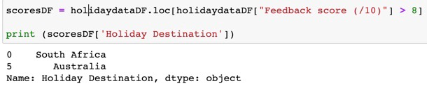
Data Selection 3
7. Filter the data by score above 8.
A high feedback score would suggest a high recommendation rate for a destination, which is useful to know.
Using a conditional statement in the selection of rows for a new dataframe, I was able to extract only those holiday destinations where the feedback score was greater than 8.
The destinations selected from the data were:
South Africa
Australia

Slide 8
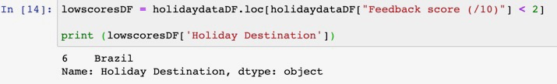
Data Selection 4
8. Filter the data score below 2
A low score may suggest a problem with a particular destination and it may need to be removed from the data.
Using a conditional statement in the selection of rows for a new dataframe, I was able to extract only those holiday destinations where the feedback score was below 2.
The result of this selection was:
- Brazil

Slide 9
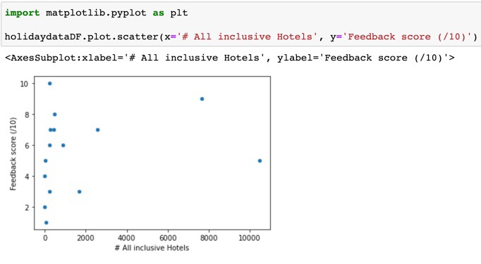
Data Visualisation
9. Is there a correlation between number of all-inclusive hotels and score?
The above data visualisation attempts to display a correlation between the number of all-inclusive hotels and feedback score that a holiday destination receives.
The results from this set of data do not show a correlation between these two criteria and suggest that a high feedback score is not related to the number of all-inclusive hotels

Slide 10
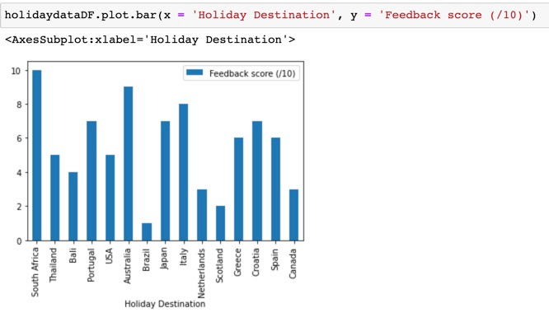
Data Visualisation 2
10. Create a data visualisation diagram to show destination and highest scores?
When making recommendations to clients on holiday destinations it would be useful to show feedback scores of various destinations. The bar chart above gives a clear visual of which destinations received the highest feedback scores.

